Slide 1
Integrate Bot and AI in your SharePoint environment
Fabio Franzini
Notes:
This slide is mandatory. Please do not remove.

Slide 2

Fabio Franzini
Office Servers & Services MVP
fabiofranzini.com
https://medium.com/@fabiofranzini/
@franzinifabio
Senior Consultant, Software Engineer and Trainer, specialized on SharePoint, Office 365 & Azure

Slide 3
Notes:
This slide is mandatory. Please do not remove and try to use it during Q&A at the end of your session. Thank you!

Slide 4
Agenda
Introduction to Microsoft AI Services
Cognitive Services
Bot & Azure Bot Service

Slide 5
INTRODUCTION TO MICROSOFT AI SERVICES

Slide 6

AI services
Bot framework
Spider
Accelerated development for conversational AI
Cognitive Services
Broad range of trained services with customization for any scenario
Azure Machine Learning
Experimentation and management services for creating AI models with productivity

Slide 7
AI services
Bot framework
Spider
Accelerated development for conversational AI
Cognitive Services
Broad range of trained services with customization for any scenario
Azure Machine Learning
Experimentation and management services for creating AI models with productivity

Slide 8
COGNITIVE SERVICES

Slide 9
What is Cognitive Services?
Microsoft Cognitive Services (formerly Project Oxford) are a set of APIs, SDKs and services available to developers to make their applications more intelligent, engaging and discoverable.
Microsoft Cognitive Services expands on Microsoft’s evolving portfolio of machine learning APIs and enables developers to easily add intelligent features such as emotion and video detection; facial, speech and vision recognition; and speech and language understanding – into their applications.

Slide 10

Cognitive Services
Vision
Language
Speech
Search
Knowledge
Computer Vision
Face
Content Moderator
Emotion
Video
Custom Vision
Video Indexer
Translator Text
Bing Spell Check
LUIS
Web Language Model
Text Analytics
Linguistic Analysis
Bing Speech
Translator Speech
Speaker Recognition
Custom Speech
Bing Autosuggest
Bing Image Search
Bing News Search
Bing Video Search
Bing Web Search
Bing Custom Search
Bing Entity Search
Recommendations
Knowledge Exploration
Entity Linking
Academic Knowledge
QnA Maker
Custom Decision

Slide 11
COGNITIVE SERVICES
DEMO

Slide 12
Text Analytics API using C#
How to detect language, analyze sentiment and extract key phrases
You must have a Cognitive Services API account with Text Analytics API in your Azure Subscription
Add NuGet Package: Microsoft.Azure.CognitiveServices.Language (Prerelease)
You could call the HTTP endpoints directly from C# but Microsoft.Azure.CognitiveServices.Language SDK makes it much easier to call the service.

Slide 13
Text Analytics API using C#
using Microsoft.Azure.CognitiveServices.Language.TextAnalytics;
Using Microsoft.Azure.CognitiveServices.Language.TextAnalytics.Models;
...
class ApiKeyServiceClientCredentials : ServiceClientCredentials
{
public override Task ProcessHttpRequestAsync(HttpRequestMessage request, CancellationToken cancellationToken)
{
request.Headers.Add("Ocp-Apim-Subscription-Key", "ENTER KEY HERE");
return base.ProcessHttpRequestAsync(request, cancellationToken);
}
}
...

Slide 14
Text Analytics API using C#
ITextAnalyticsAPI client = new TextAnalyticsAPI(new ApiKeyServiceClientCredentials()); client.AzureRegion = AzureRegions.Westeu;
...
var result = await client.DetectLanguageAsync(new BatchInput(new List<Input>()
{
new Input("1", "This is a document written in English."),
new Input("2", "Este es un document escrito en Español.")
}));
...
var result2 = await client.KeyPhrasesAsync(new MultiLanguageBatchInput(
new List<MultiLanguageInput>() {
new MultiLanguageInput("ja", "1", "猫は幸せ"),
new MultiLanguageInput("en", "3", "My cat is stiff as a rock."),
new MultiLanguageInput("es", "4", "A mi me encanta el fútbol!")
}));
...

Slide 15
Text Analytics API using C#
...
SentimentBatchResult result3 = await client.SentimentAsync(
new MultiLanguageBatchInput(new List<MultiLanguageInput>()
{
new MultiLanguageInput("en", "0", "I had the best day of my life."),
new MultiLanguageInput("en", "1", "This was a waste of my time. The speaker put me to sleep."),
new MultiLanguageInput("es", "2", "No tengo dinero ni nada que dar..."),
new MultiLanguageInput("it", "3", "L'hotel veneziano era meraviglioso. È un bellissimo pezzo di architettura.")
}));
...

Slide 16
Simple Scenario for Text Analytics
The choice of good quality images for SharePoint News can be complicated
You can use a public repository of royalty free images like Pixabay, Pexels, ect
You can automate the choice of this images using Cognitive Service

Slide 17
COGNITIVE SERVICES + SHAREPOINT
DEMO

Slide 18
BOT & AZURE BOT SERVICE

Slide 19

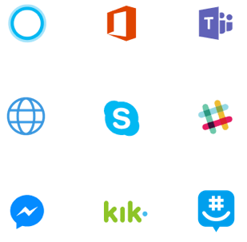
What is a Bot?
A bot is an app that users interact with in a conversational way using text, graphics (cards), or speech.
It may be a simple question and answer dialog, or a sophisticated bot that allows people to interact with services in an intelligent manner.

Slide 20







What is the Azure Bot Service?
What?
Channels
Hosting services
Tools
Business logic and data
Bot Connector
Why?
Implements standard protocols
Modeling conversations is hard
UI across multiple canvases is hard
Language understanding is hard
Common and well understood patterns
C#
BOT BUILDER
Bot Controls
Goals
Start simple. Add complexity. No dead-ends.
Bot adapts to the user, based on context
Composable and intelligent controls to manage complexity
Skype
Bing
Web Chat
LUIS
Form filling
Q&A
LUIS
Skype for Business
Cortana
Direct Line
Query over database via Azure Search
Third-Party

Slide 21
Common Business Scenarios
Customer Support
Helping users find information and complete simple tasks without the need of human assistance.
Employee Productivity
Increase employee engagement, simplify common internal tasks and provide immediate answers to general knowledge questions

Slide 22
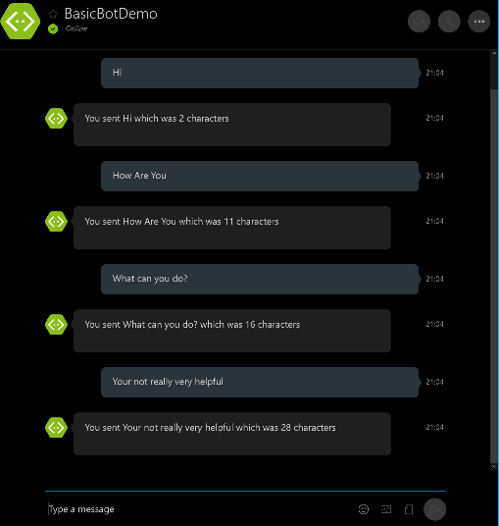
Bots are not intelligent out of the box.

Slide 23
Bots + Cognitive Services
Maps
Computer
Vision
Spelling
Custom
Vision
Bing
Entity
Text
Analytics
LUIS
Translator

Slide 24
AZURE BOT SERVICE
DEMO

Slide 25
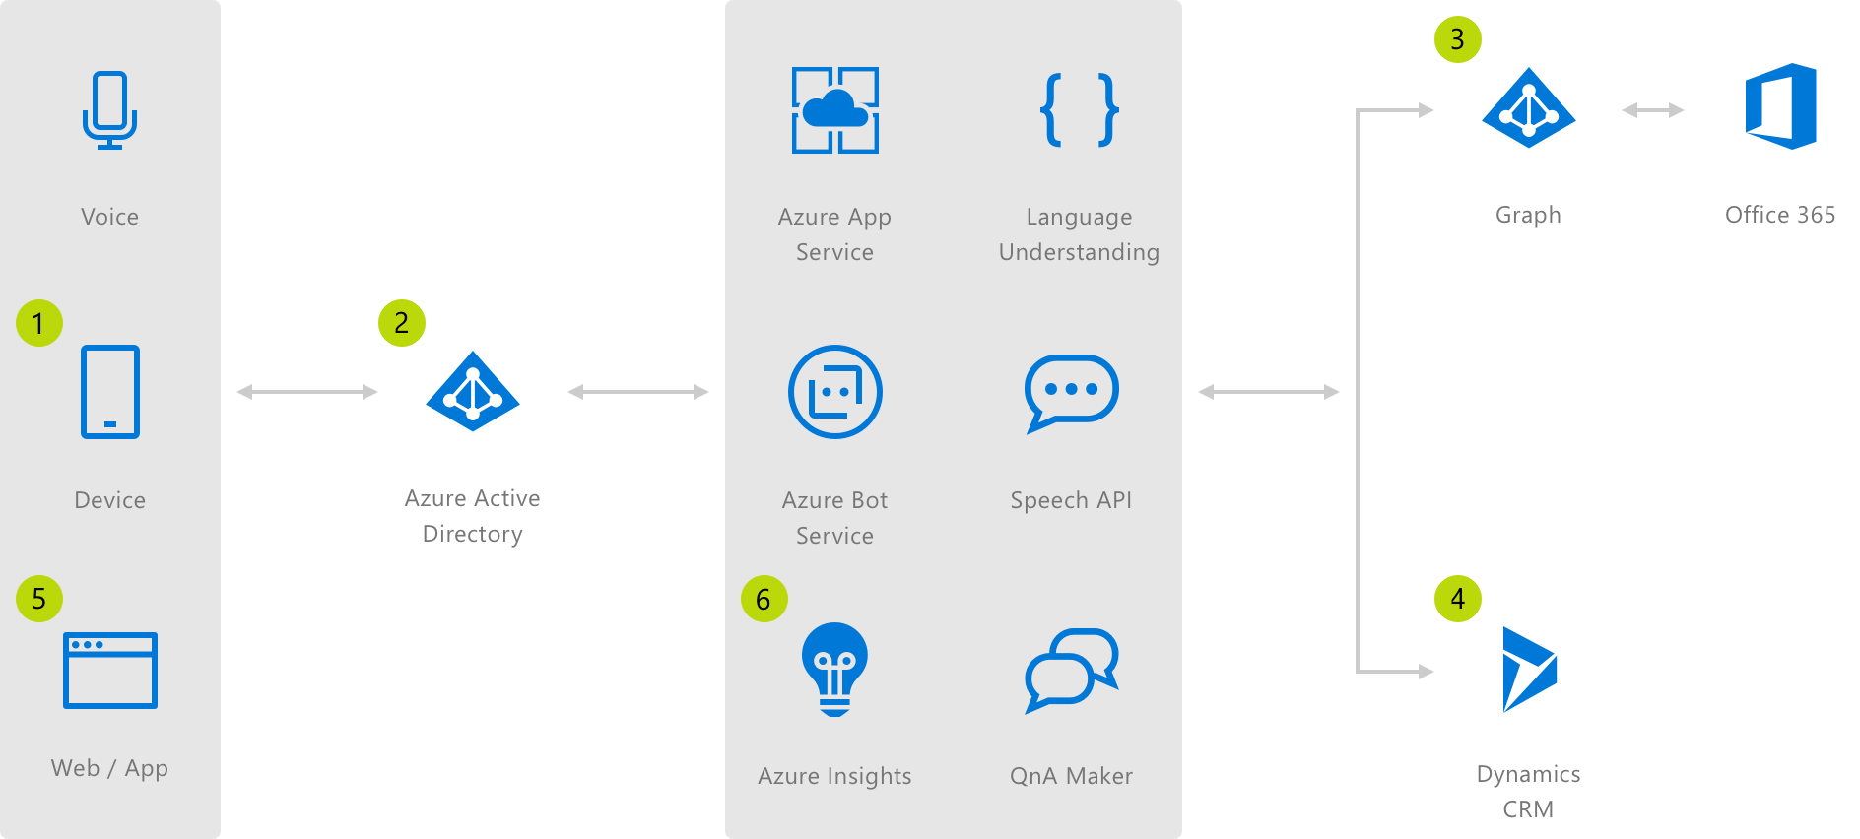
Enterprise Chatbot Scenario
Employee accesses Enterprise Productivity Bot
Azure Active Directory validates the employee's identity
The bot is able to query the employee's Office 365 calendar via the Azure Graph
Using data gathered from the calendar, the bot accesses case information in Dynamics CRM
Information is returned to the employee who can filter down the data without leaving the bot
Application insights gathers runtime telemetry to help the development with bot performance and usage

Slide 26
SharePoint Scenario
SharePoint Admin Bot by Rick Van Rousselt (The SharePoint Admin Bot is an attempt to make the everyday routinous jobs that a SharePoint Online Administrator or Power User easier): https://github.com/RickVanRousselt/SharePointAdminBot
SharePointBot by Laurent Ellerbach (A Bot using Microsoft Graph for SharePoint, Azure Active Directory authentication and Q&A Maker supported in email channel as well): https://github.com/Ellerbach/SharePointBot

Slide 27
AZURE BOT SERVICE + SHAREPOINT
DEMO

Slide 28

SharePoint Admin Bot

Slide 29
Notes:
This slide is mandatory. Please do not remove and try to use it during Q&A at the end of your session. Thank you!

Slide 30
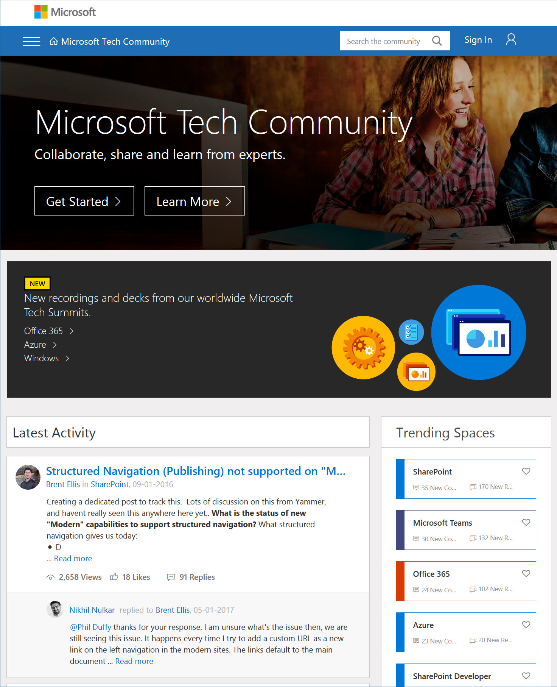
Microsoft Tech Community
techcommunity.microsoft.com
One Microsoft community for IT Pros and tech enthusiasts to learn from experts on Microsoft products
Trusted resource for news, best practices and answers from Microsoft product teams and MVPs
Join today! It’s free – sign in with your Microsoft Account.

Slide 31
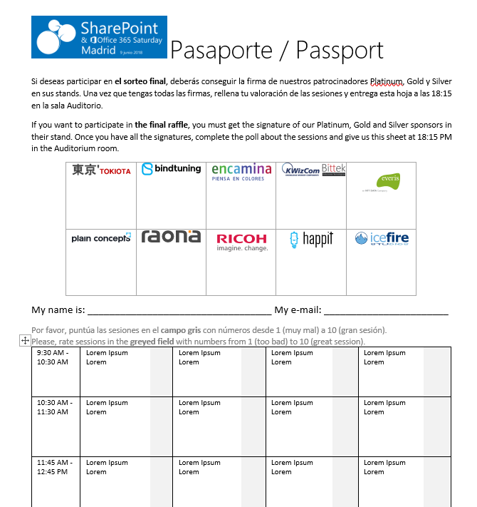




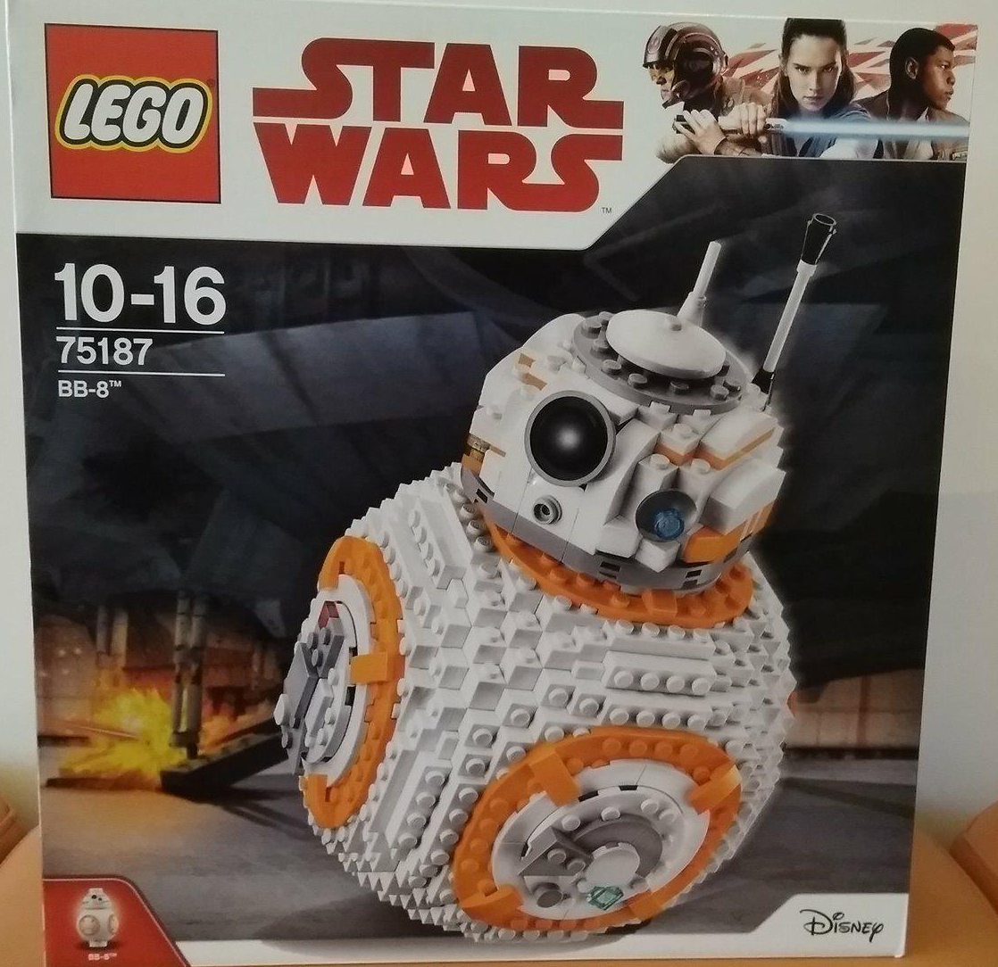


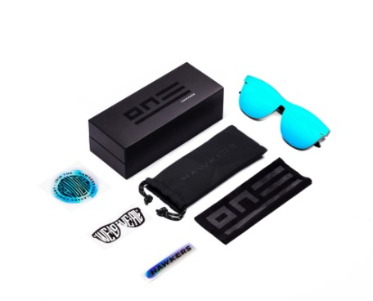







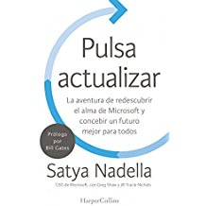
Raffle
Please, fill your SP & Office 365 Saturday Madrid passport if you want to participate.
You can win one of these gifts:
Please, fill your SP & Office 365 Saturday Madrid passport if you want to participate.
You can win one of these gifts:
Odor
Odor@winterfell.com
10
9
2x
2x
8

Slide 32
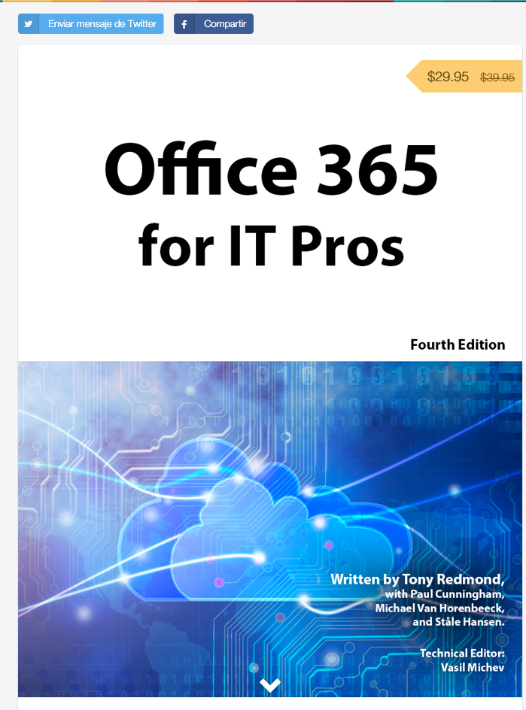
Office 365 for IT Pros
Get a discount of $10 buying the book here: https://gumroad.com/l/O365IT/spsspain

